Slide 1





Movie Database
GROUP 13
Group Members:
Nishita Matlani
Aishwarya Dhandore
Suchita Dabir
Sangram Anil Shinde
Venkata Durga Hemanth Narsupalli

Slide 2



PURPOSE
The project aims to streamline the process of adding, updating, and organizing movie data, making it accessible and manageable for users.
It provides an interface for cataloguing and retrieving movie details, including titles, genres, release years, and user-generated content.
The MDBMS enhances the movie-watching experience by offering users easy access to movie information, reviews, and ratings.
It fosters user engagement through interactive features that allow users to rate movies, leave reviews, create watchlists, and engage with fellow movie enthusiasts.

Slide 3

Higher-Level Design
----------------------------------------------------------------------------
Requirements
Identification
Determine data schema
Develop data access layer
Implement security measures
We started by determining what data needs to be stored, how it will be accessed, and what types of reports and analyses will be needed for Movie Database management
Based on the requirement we identify the different types of entities, such as Movie, Cast & crew, and Awards, and their relationships.
After creating the ER diagram,
we start developing the DDL and DML for our database
We have implemented Encryption for the Username and Password field in Users table to make it secure

Slide 4

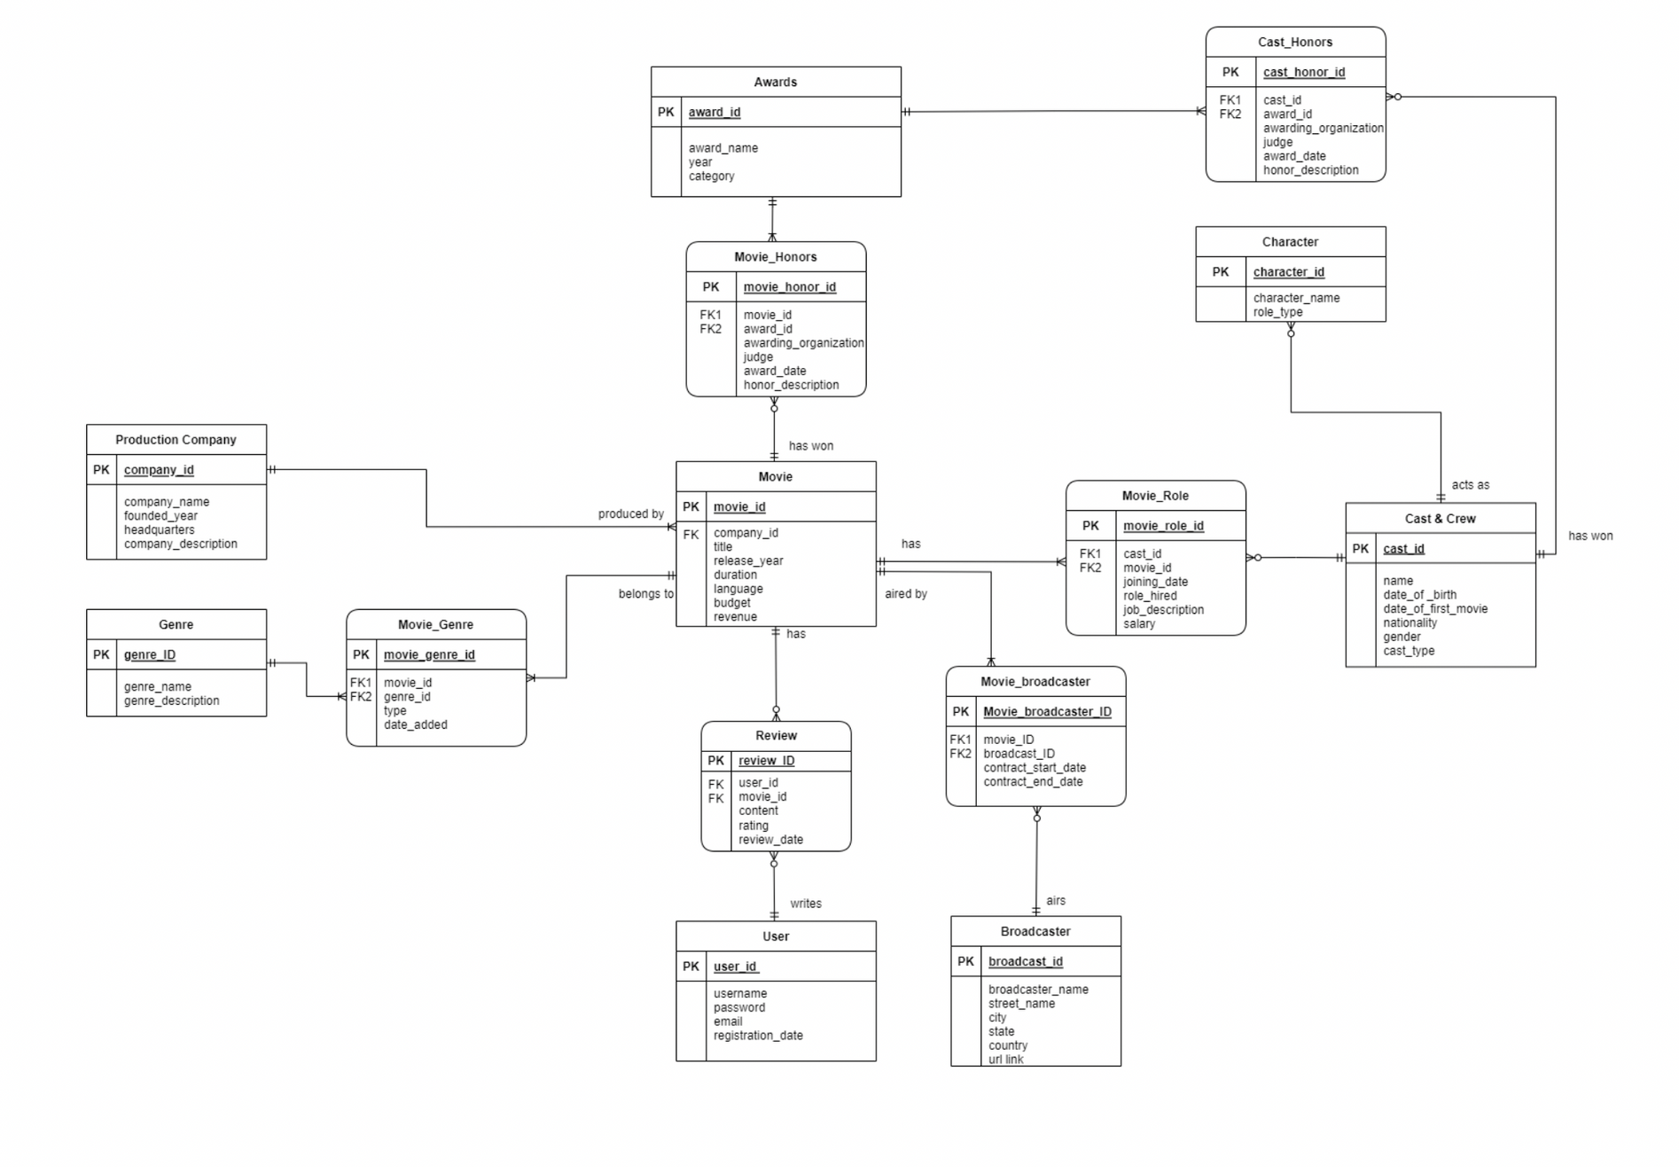


ER DIAGRAM

Slide 5
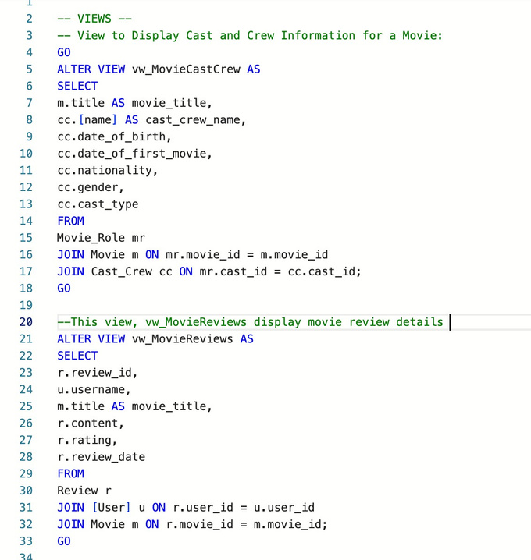
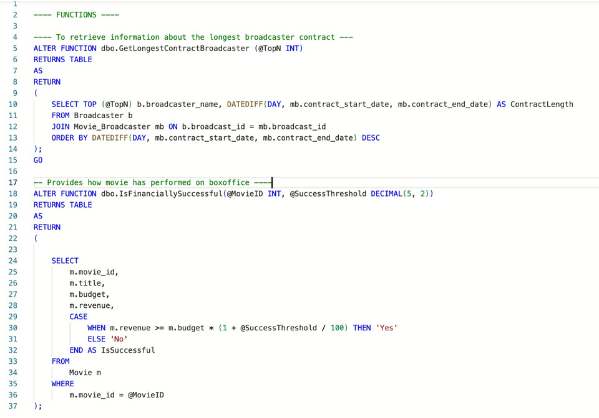
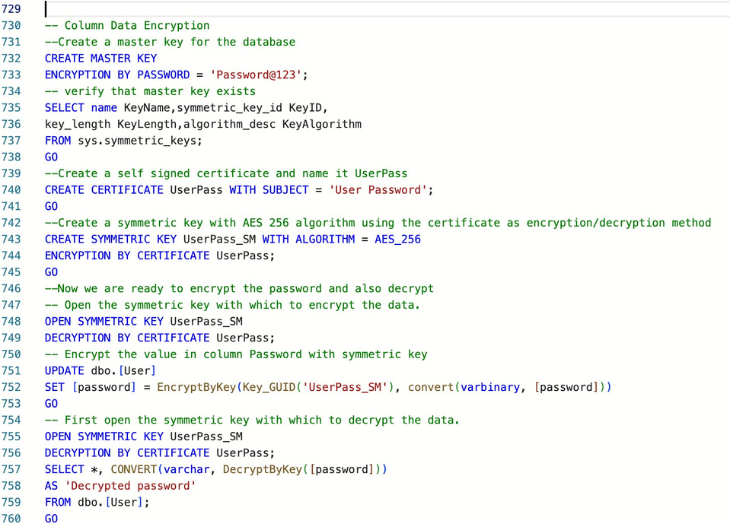
DATABASE OBJECTS CRAFTED
UDF
VIEWS
COLUMN DATA ENCRYPTION

Slide 6

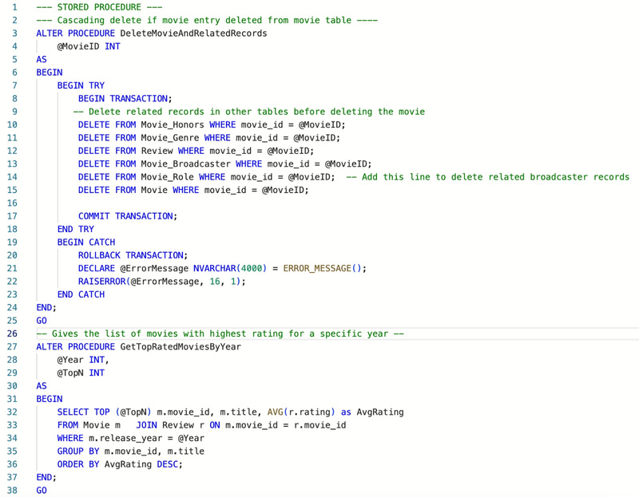
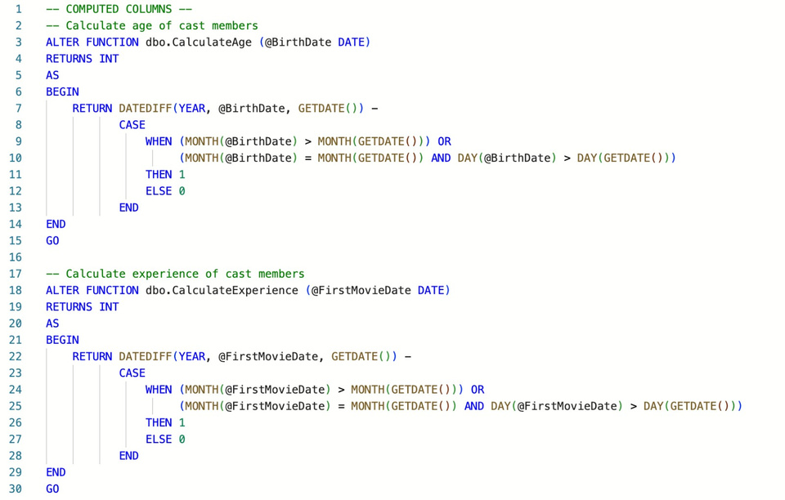
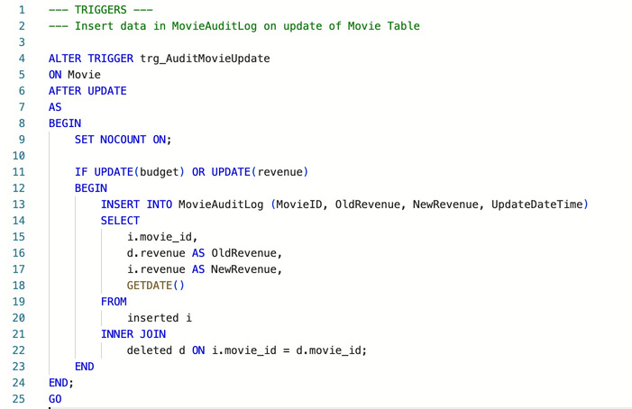
DATABASE OBJECTS CRAFTED
TRIGGERS
COMPUTED COLUMNS
STORED PROCEDURES

Slide 7


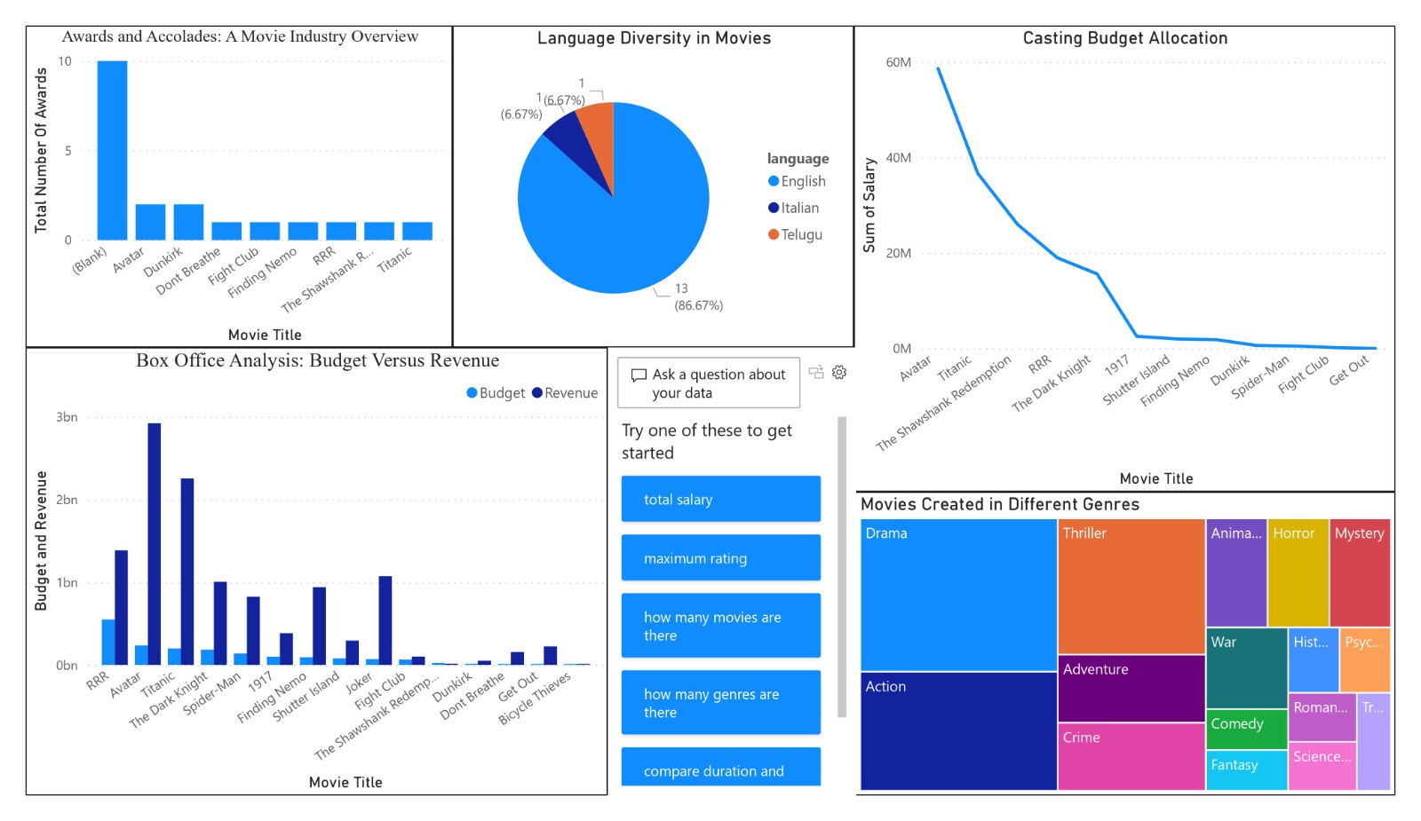
DATA VISUALIZATION

Slide 8
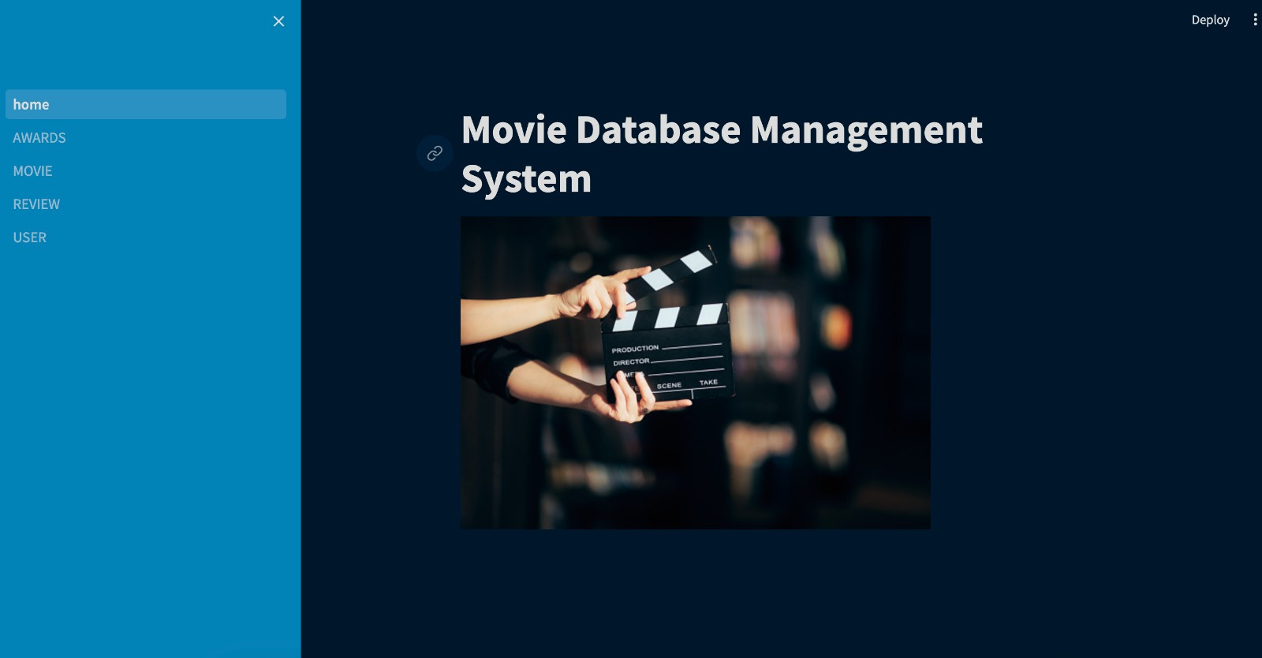
GUI

Slide 9
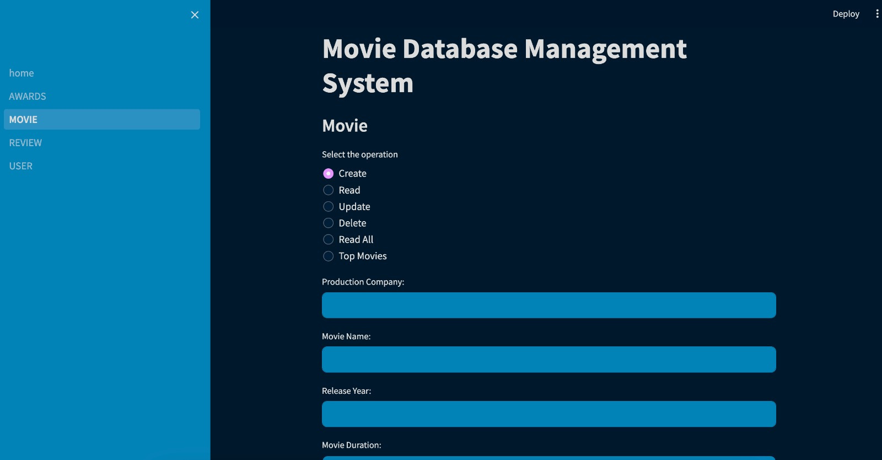
GUI

Slide 10



THANKYOU

